Slide 1

Cancer Detection
Presenter: Jianhai Su

Slide 2
Overview
Problem
Challenge
Research Status
Our Current Approach
Result and Analysis
Other Interesting Approaches

Slide 3
Problem
Given:
Sample set X: n samples, m dimensions. m >> n. (n=334, m~400k)
Label set Y: {“Cancer”, “Clear”}
Task:
Build a classifier to accurately assign label to unseen samples
Find most influential features
Classifier: Few samples + Ultra high dimensional features

Slide 4
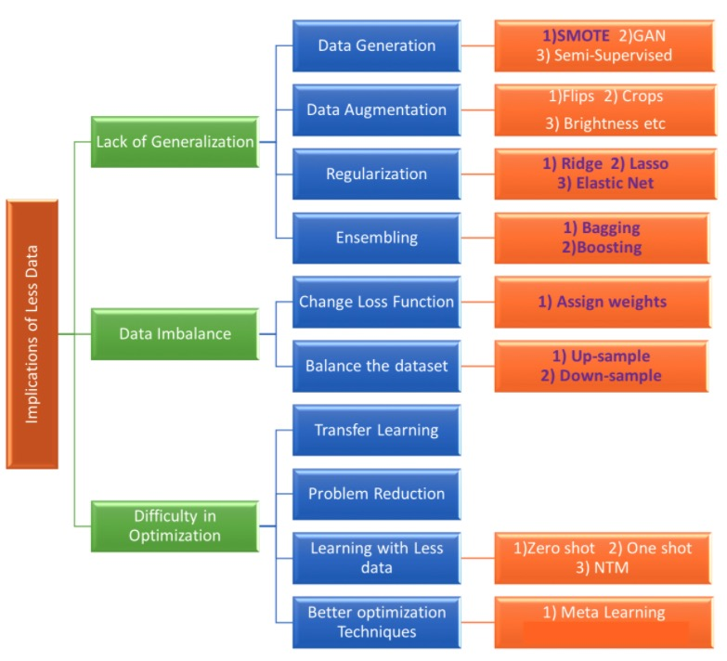
Challenge
C1: Few Samples
C2: Ultra High Feature Dimensionality
Computationally costly
Very long Training time
Model Underfit

Slide 5
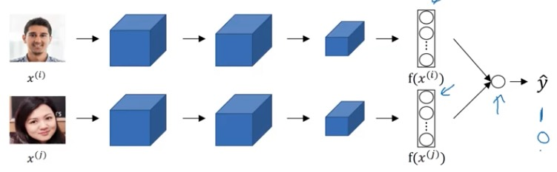
Research Status
Feature Selection: Hilbert-Schmidt Independence Criterion (HSIC) Lasso
minimum redundancy maximum relevance
Scalable, Stable, and more accurate
One Shot Learning with Siamese Networks
Deep Neural Pursuit
Representative Image
Siamese Network
Test Image

Slide 6
Approach: HLBO
HSIC Lasso: select features
Classification Model: Random Forest / Support Vector Machine
Meta-Learning: Bayesian Optimization

Slide 7
Dataset Statistics
 | Young | Old | All
Total | 44 | 290 | 343
Cancer | 21 | 80 | 101
Clear | 23 | 210 | 242
Ca VS Cl | 21/23 | 80/210 | 101/242
 | 0.9 vs 1 | 1 vs 2.6 | 1 vs 2.4
Base Profiles |  | Accuracy
Age Group | Young | Old | All
Random Guess | 0.5 | 0.5 | 0.5
Always Clear | 0.5227 | 0.7241 | 0.7055
Always Cancer | 0.4773 | 0.2759 | 0.2945

Slide 8
Experiment
Training set vs Testing set: 60% vs 40%
NumFeatsList = [5, 10, 30, 50, 70, 100, 150, 200, 400, 600, 800, 1000]
Age Group: All, Young, Old
Max Actually Extracted Features: All (111), Young (60), Old (108)
Best Test Accuracy (using All samples): 97.01%
Random Forest < Support Vector Machine
Github: github.com/softsys4ai/CancerDetection.git (currently private)

Slide 9
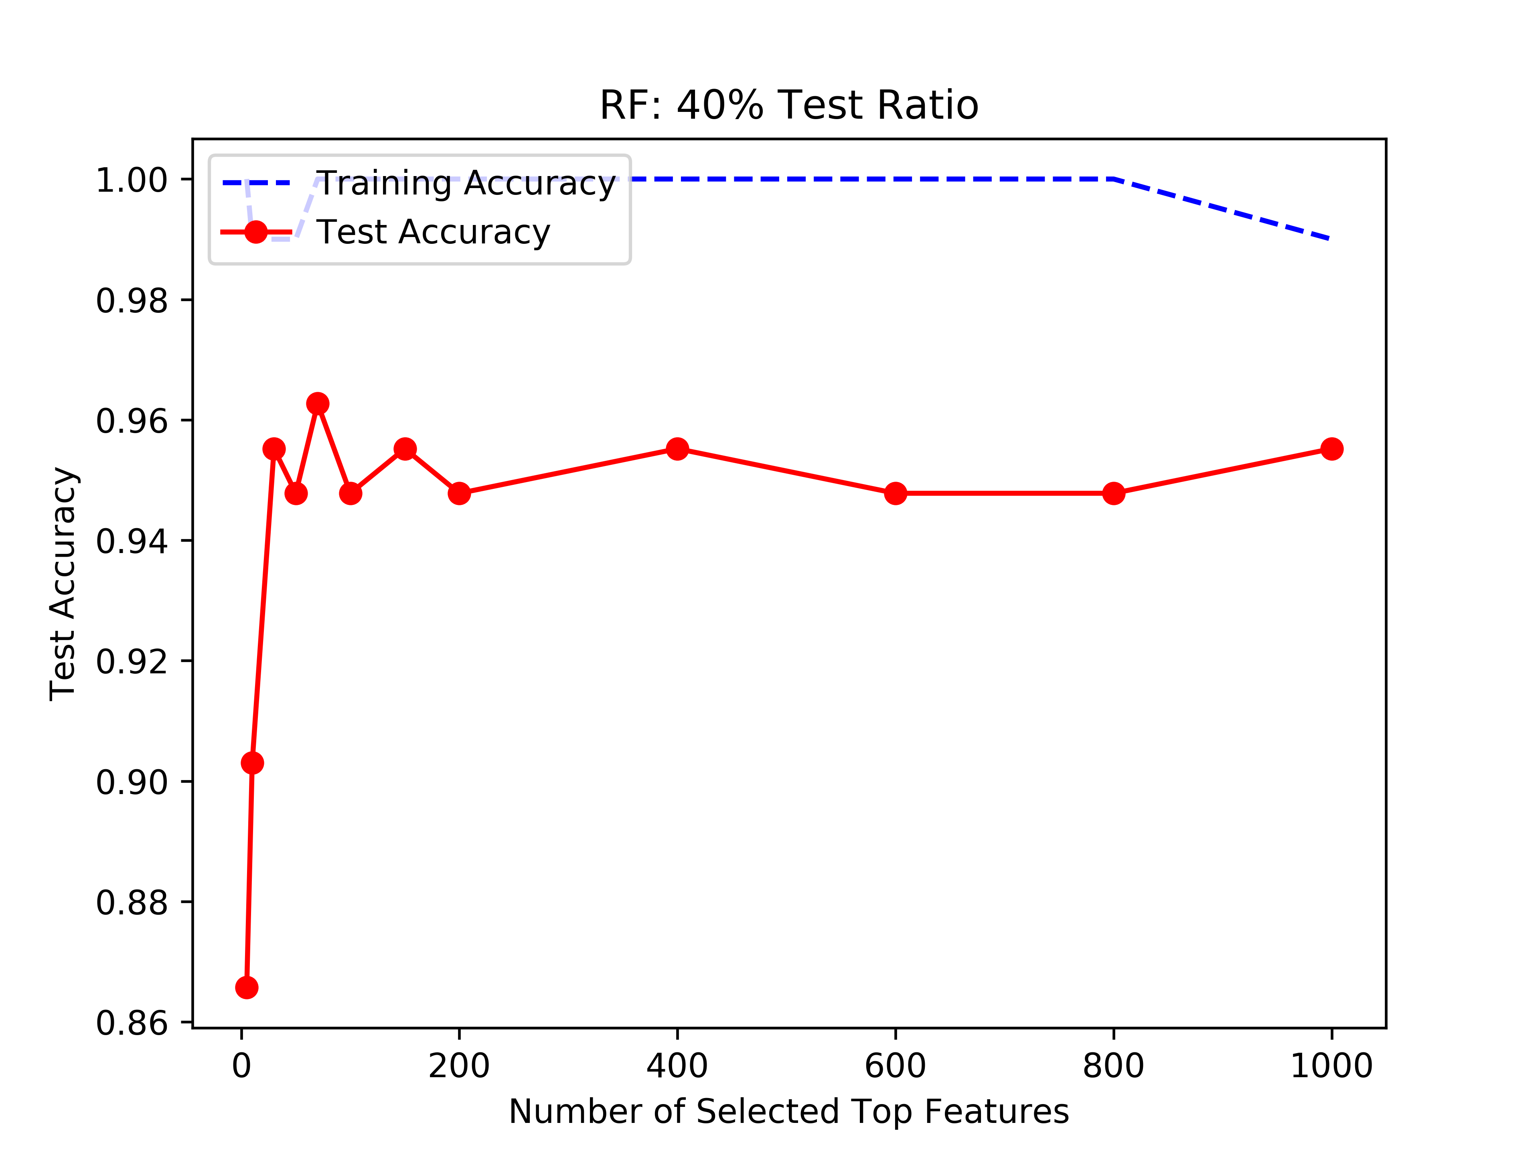
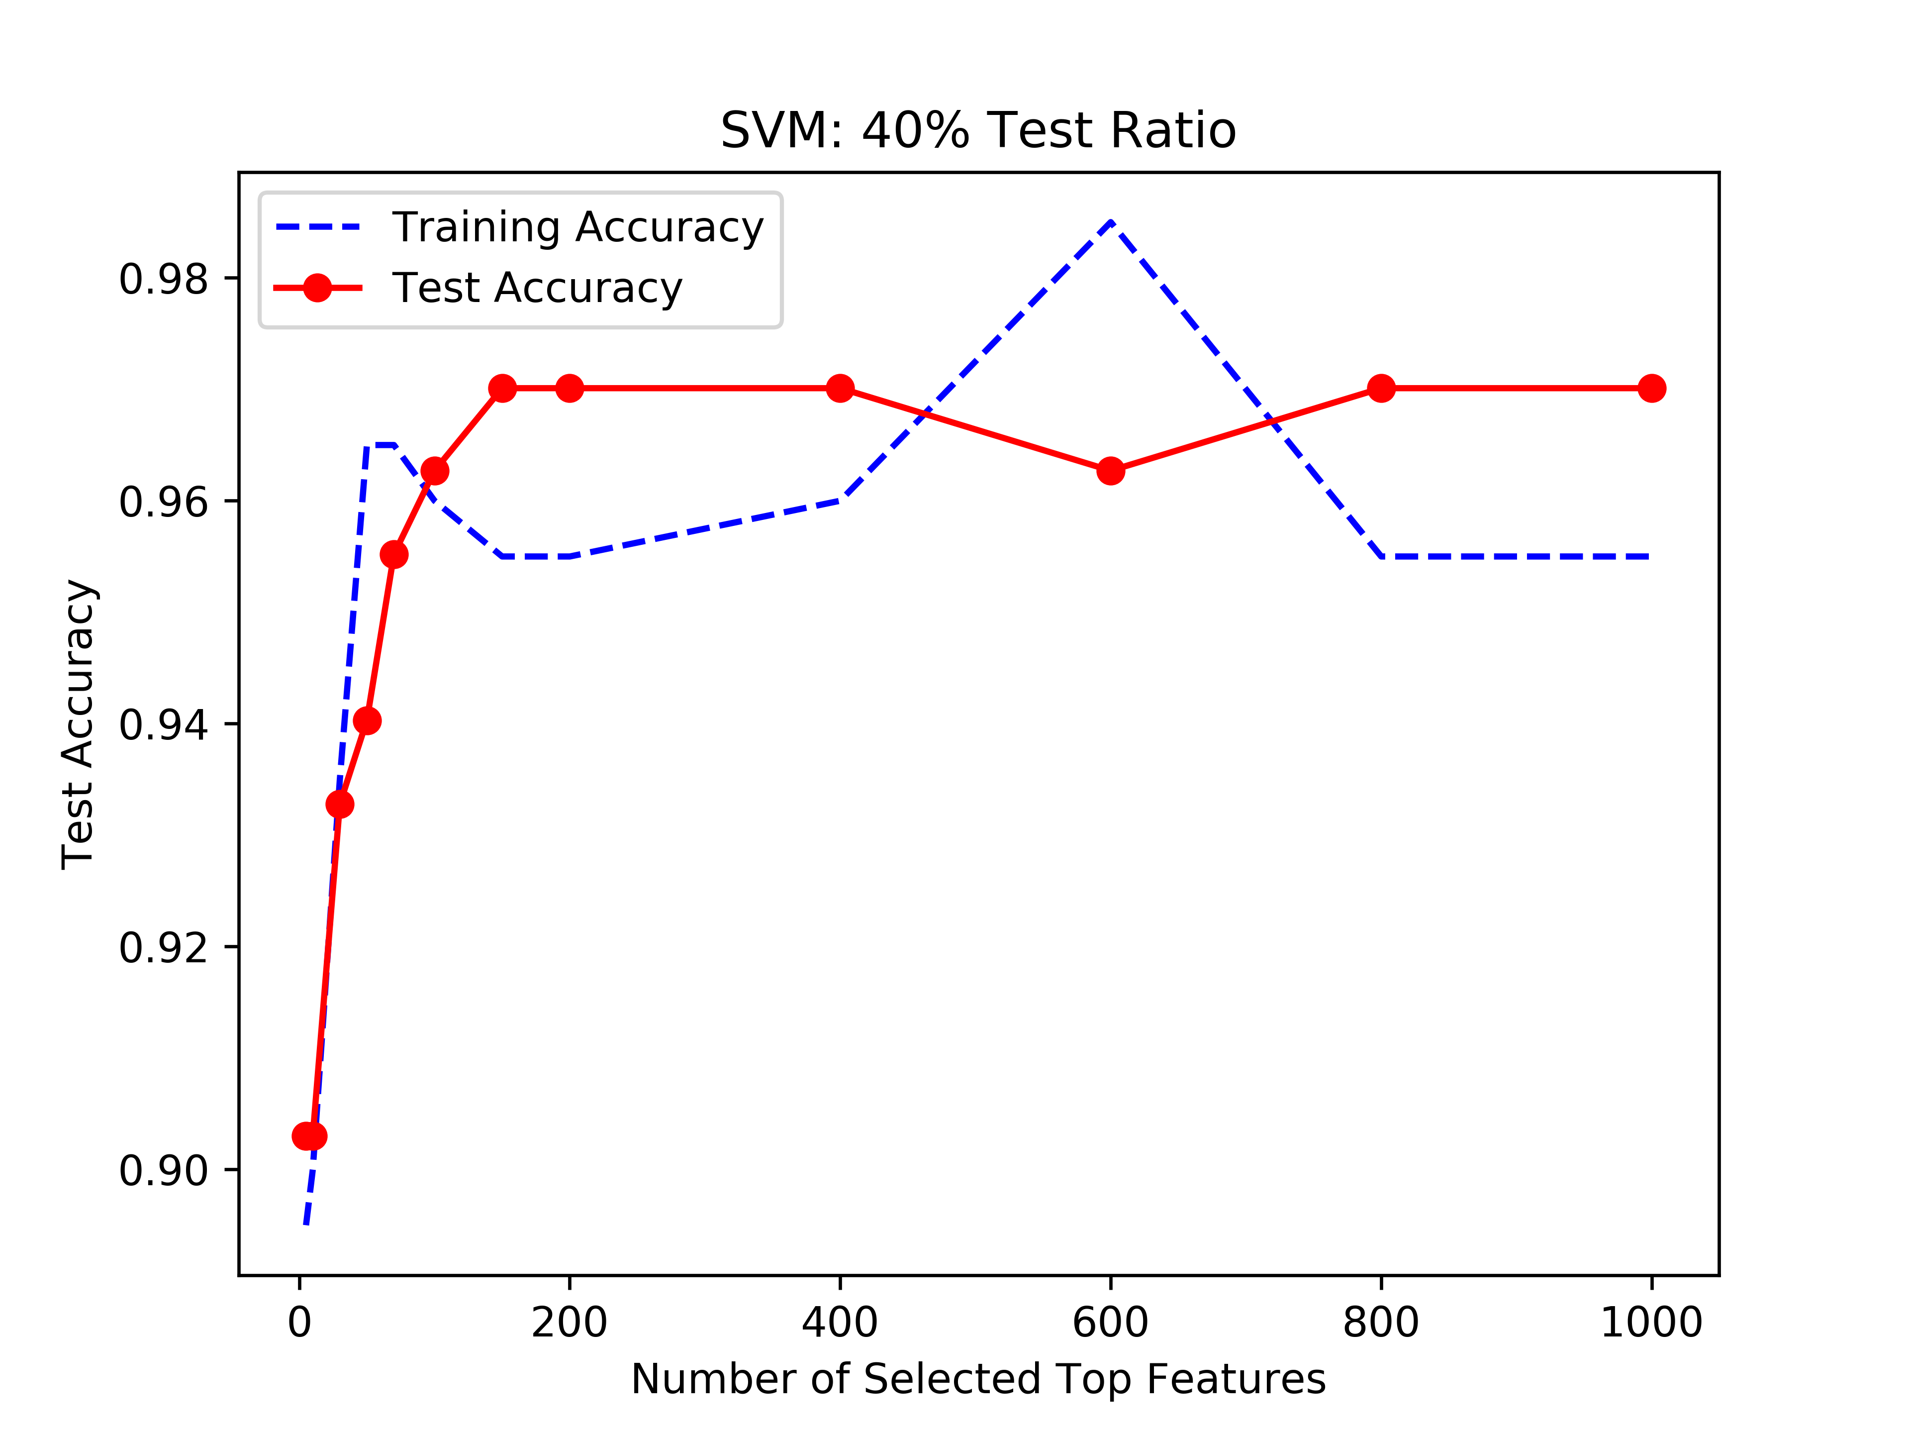
Result: Age Group - All

Slide 10
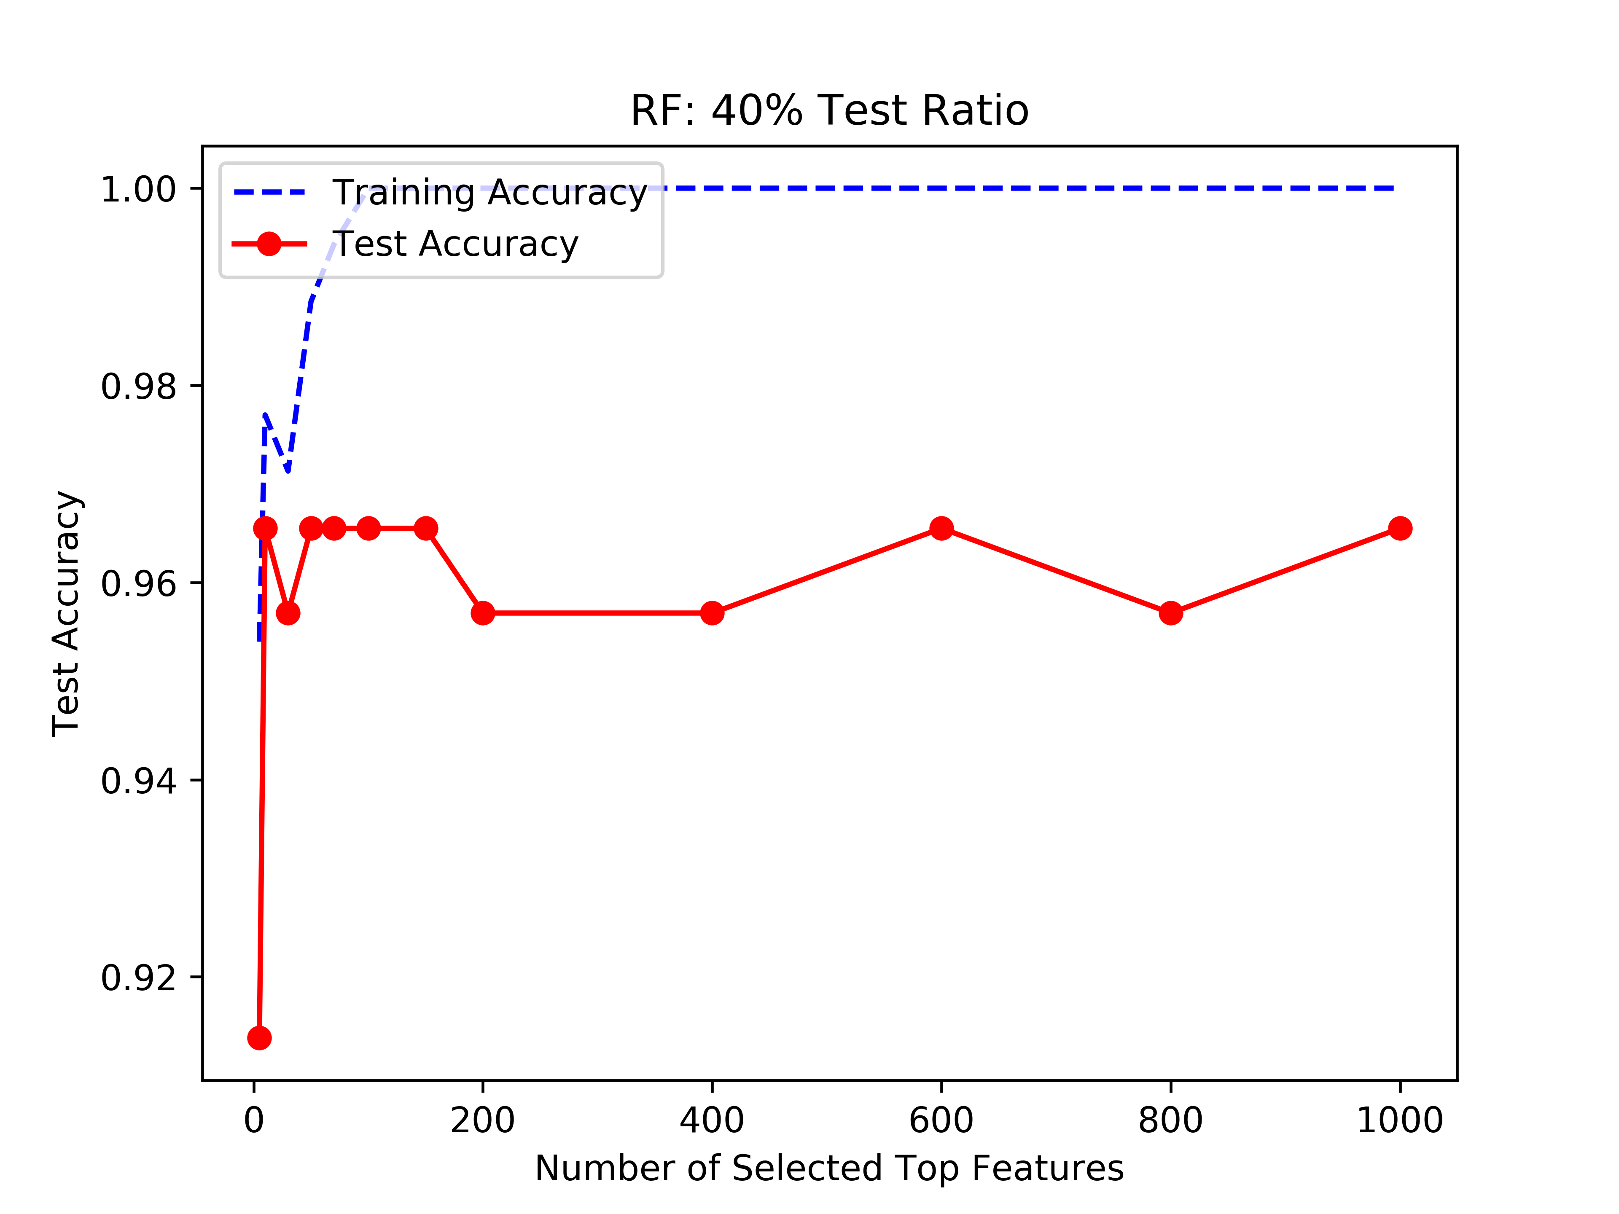
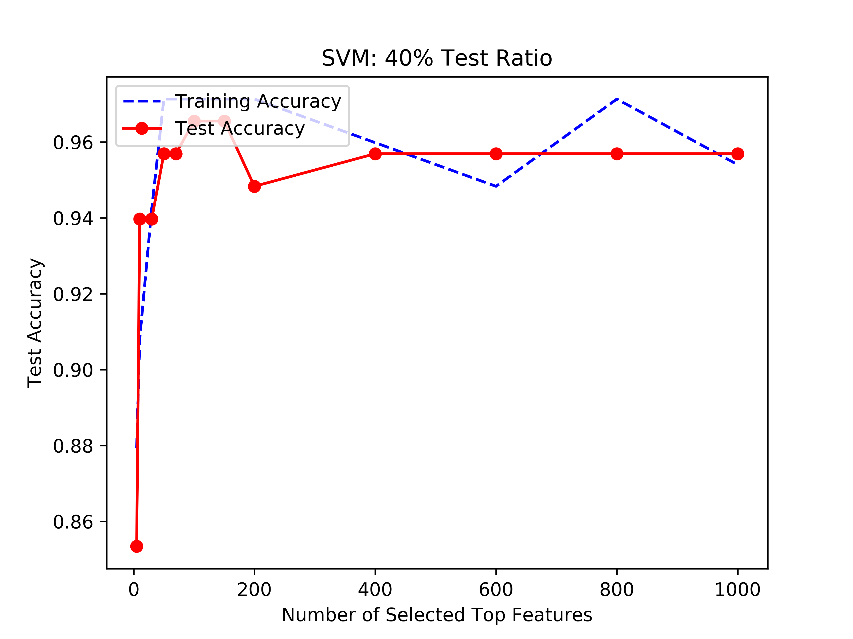
Result: Age Group - Old

Slide 11
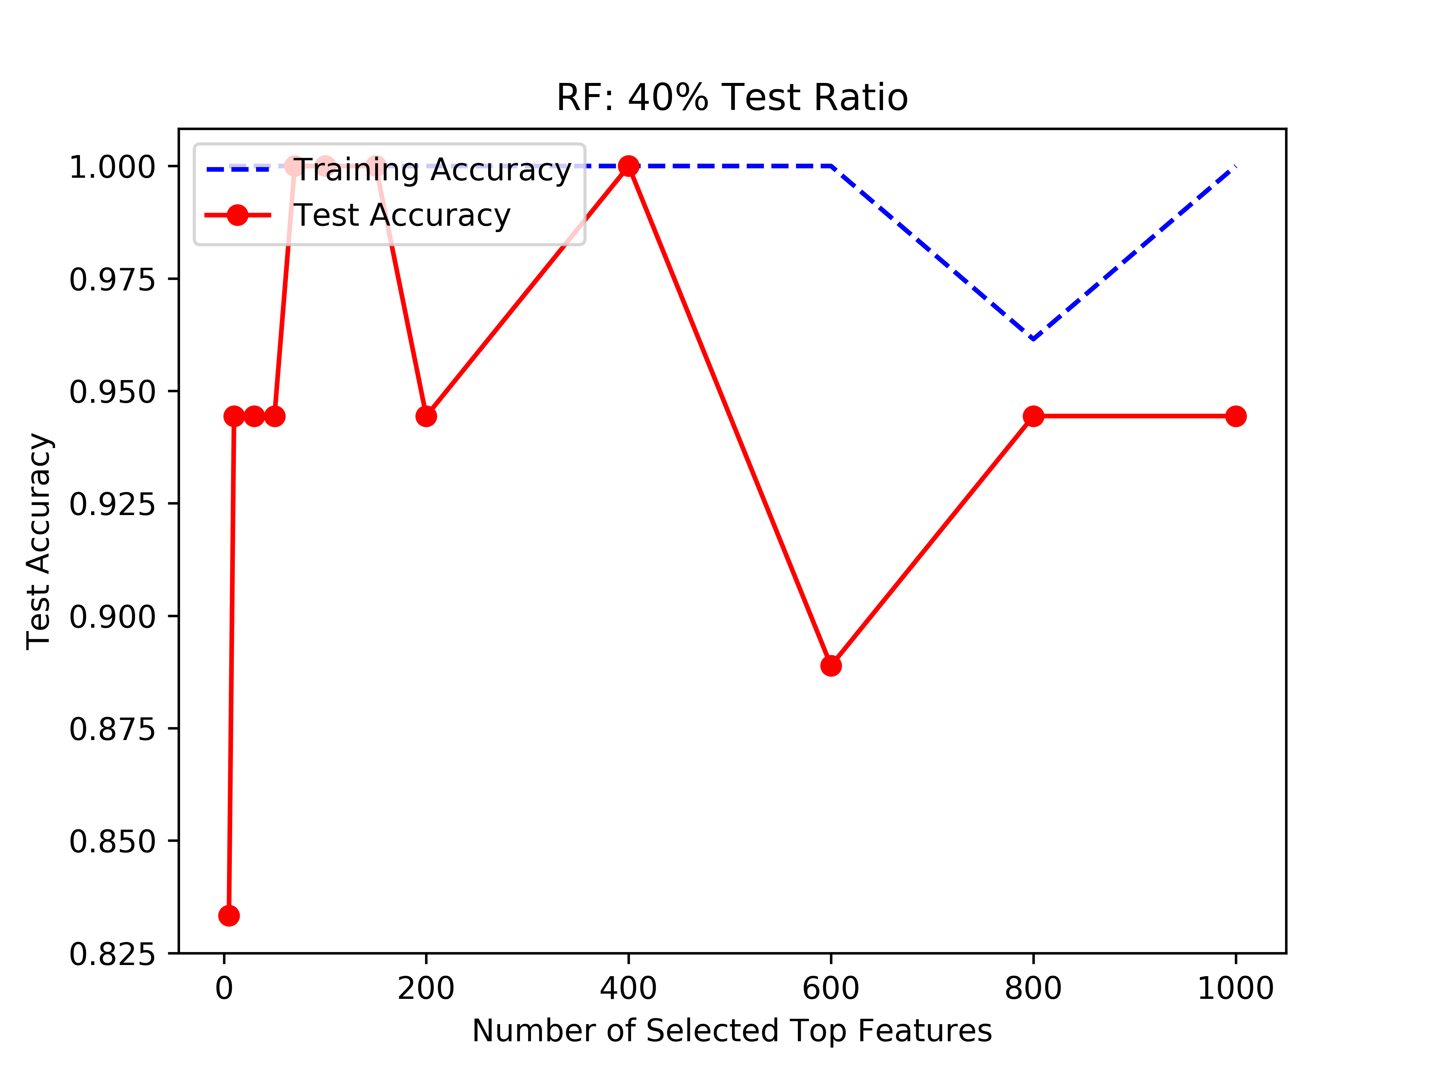
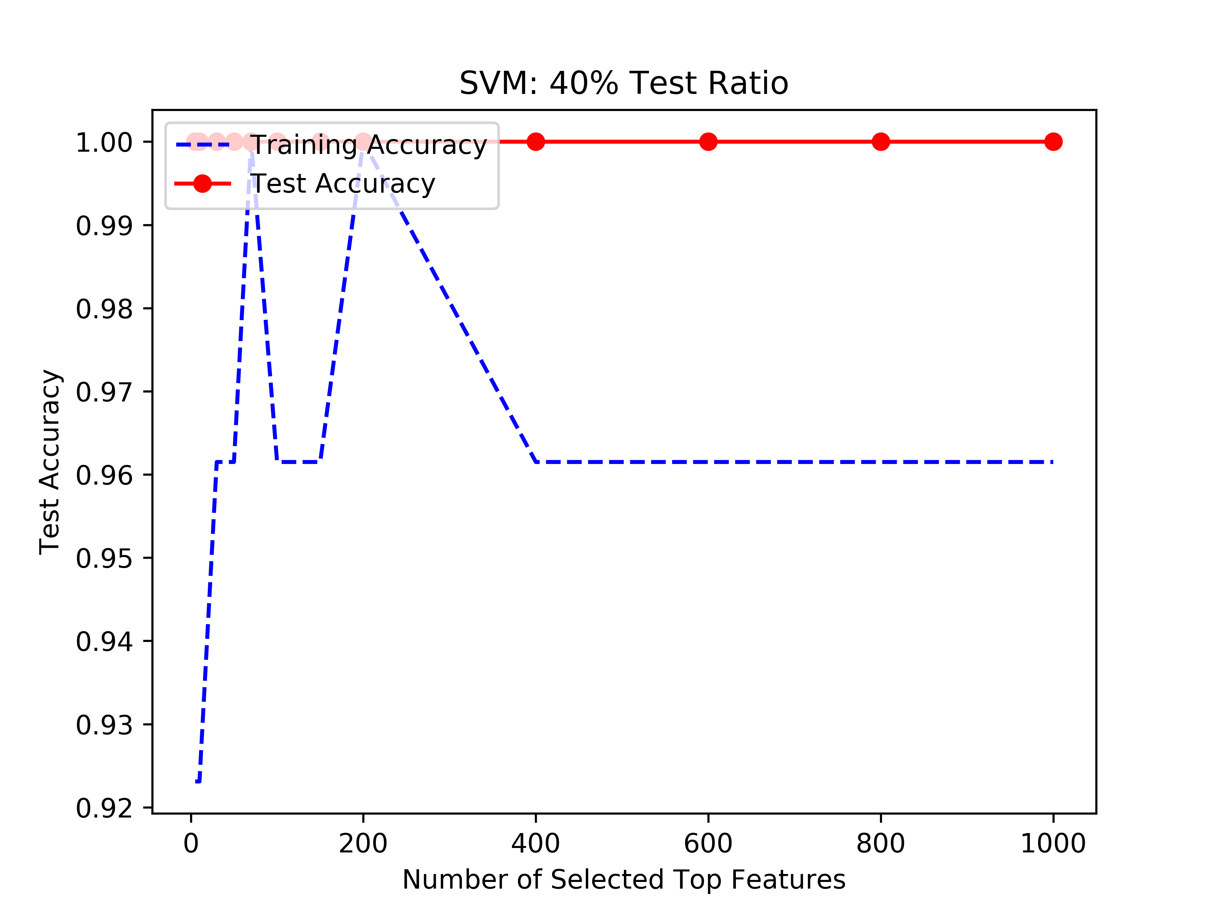
Result: Age Group - Young

Slide 12
Result: Test Accuracy
Testing on the dataset of the same age group
Age Group | # of Features | SVM-Best | SVM-Mean | RF-Best | RF-Mean
Young | 60 | 1.0 | 1.0 | 1.0 | 0.9653
Old | 108 | 0.9655 | 0.9580 | 0.9655 | 0.9623
All | 111 | 0.9701 | 0.9689 | 0.9552 | 0.9515
Testing on the dataset of different age groups
RF-150 |  | Test
Train | All | Young | Old
All | 0.982 | 0.9318 | 0.9897
Young | 0.8623 | 1 | 0.8414
Old | 0.9641 | 0.8182 | 0.9862
SVM-150 |  | Test
Train | All | Young | Old
All | 0.9611 | 0.9773 | 0.9586
Young | 0.8353 | 0.9773 | 0.8138
Old | 0.9581 | 0.8864 | 0.969

Slide 13
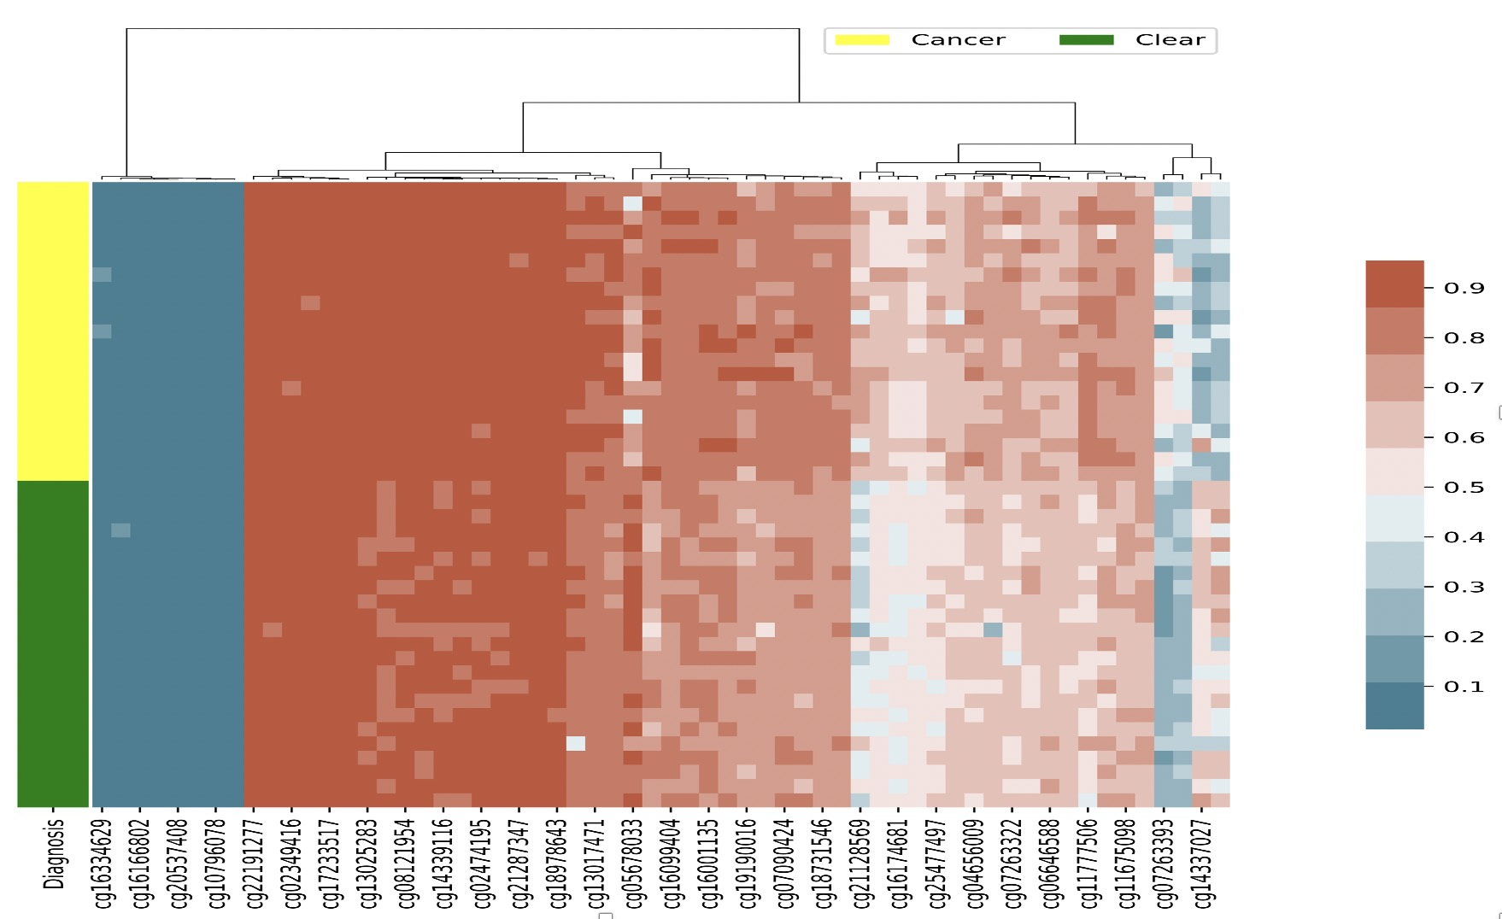
Feature Clustering Analysis – Young (60)

Slide 14
Feature Clustering Analysis – Young (60)

Slide 15
Feature Clustering Analysis – Young (13)

Slide 16
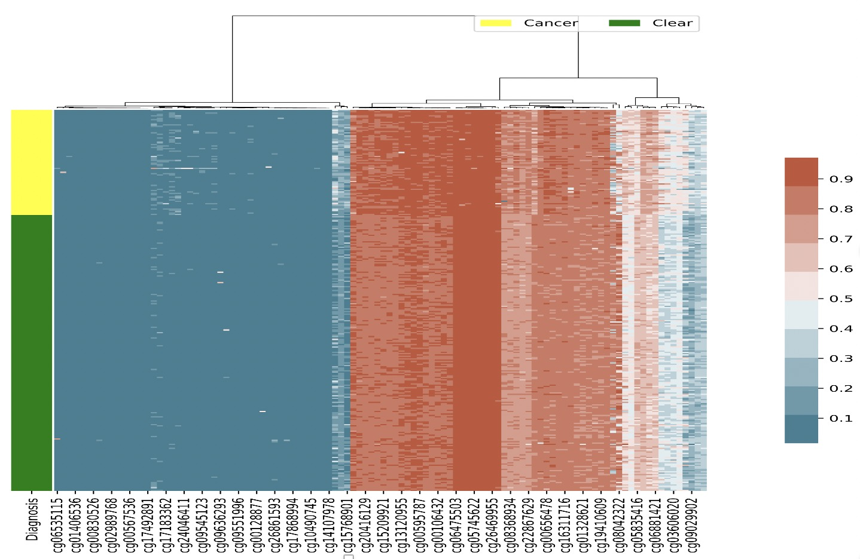
Feature Clustering Analysis – Old (108)

Slide 17
Feature Clustering Analysis – Old (108)

Slide 18
Feature Clustering Analysis – Old (50)

Slide 19
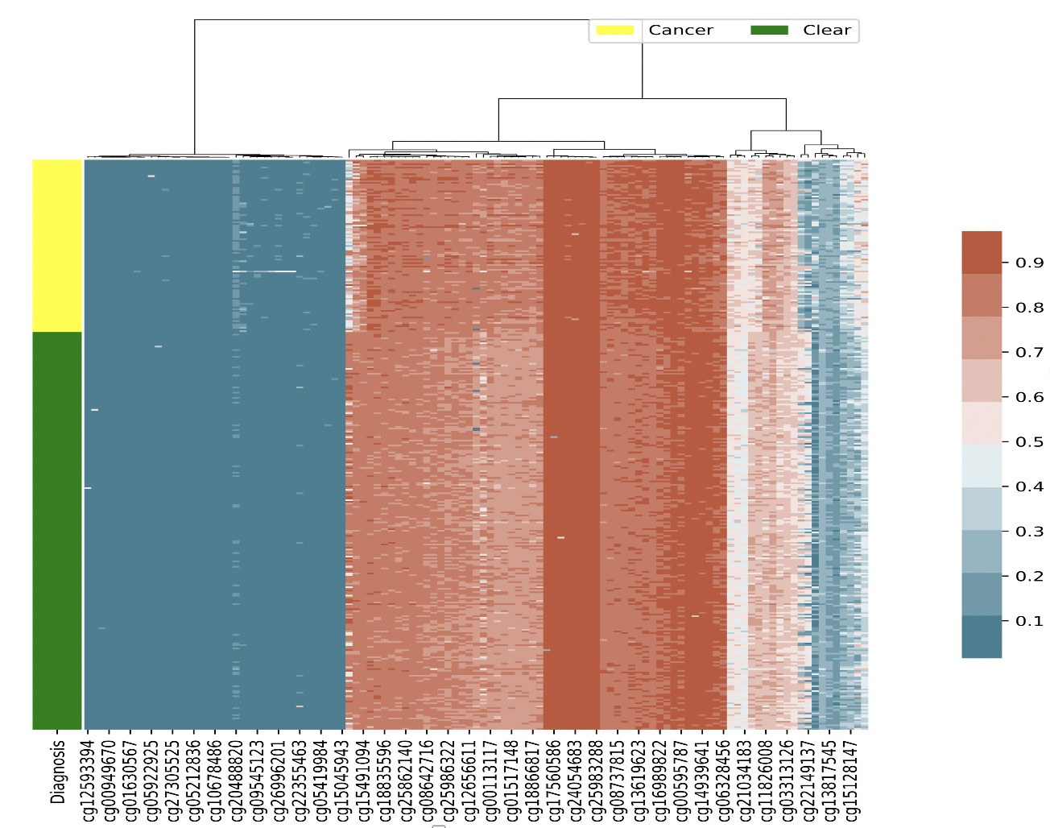
Feature Clustering Analysis – All (111)

Slide 20
Feature Clustering Analysis – All (111)

Slide 21
Feature Clustering Analysis – All (55)

Slide 22
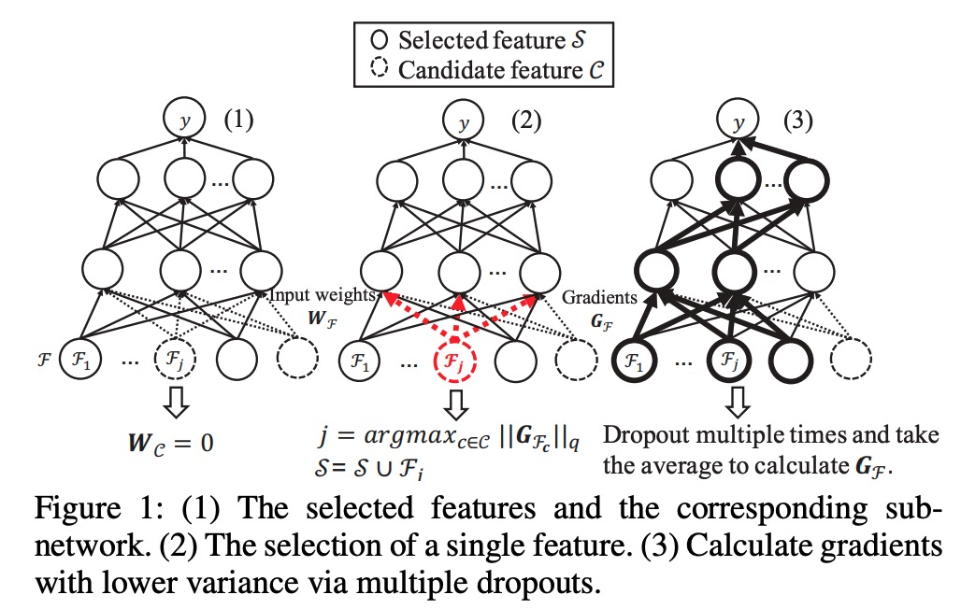
Deep Neural Pursuit
Deep Neural Networks for High Dimension, Low Sample Size Data. Bo Liu, Ying Wei, Yu Zhang, Qiang Yang. 2017 IJCAI

Slide 23
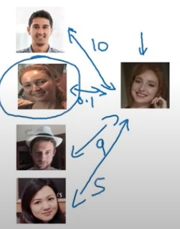
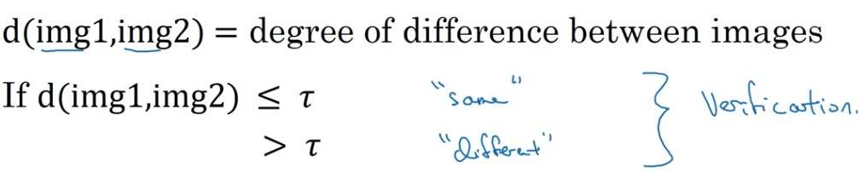
One Shot Learning with Siamese Networks
Face Detection: each person only has one sample in the training set
Siamese Neural Networks for One-shot Image Recognition. Gregory Koch, Richard Zemel, Ruslan Salakhutdinov. 2015 ICML

Slide 24
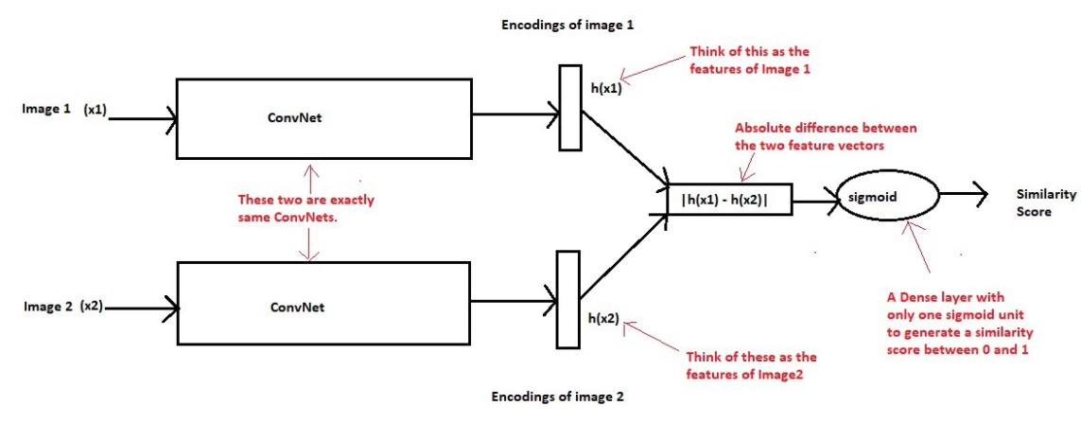
Siamese Networks

Slide 25
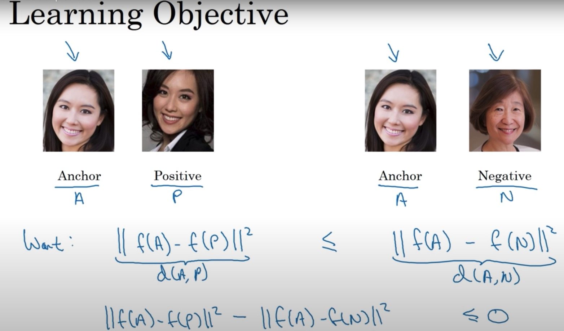
Siamese Networks

